Slide 1
Intent
An intent is an abstract description of an operation to be performed
It is an object that provides runtime binding between separate components, such as two activities.
.Its most significant use is in the launching of activities, where it can be thought of as the glue between activities.
You can use intents for a wide variety of tasks

Slide 2
Intent – Example
Here , your intent starts another activity and pass data to it
The Intent constructor takes two parameters:
A Context as its first parameter (this is used because the Activity class is a subclass of Context)
The Class of the app component to which the system should deliver the Intent (in this case, the activity that should be started).

Slide 3
Intent – Example
The putExtra() method adds the EditText's value to the intent.
An Intent can carry data types as key-value pairs called extras.
Your key is a string constant, because the next activity uses the key to retrieve the text value.
It's a good practice to define keys for intent extras using your app's package name as a prefix.

Slide 4
Intent – Example
The putExtra() method adds the EditText's value to the intent.
An Intent can carry data types as key-value pairs called extras.
Your key is a string constant, because the next activity uses the key to retrieve the text value.
It's a good practice to define keys for intent extras using your app's package name as a prefix.

Slide 5
Intent – Example
The startActivity() method starts an instance of the second activity specified by the Intent.
The second activity to display the message that was passed by the first activity.
Intent intent = getIntent(); String message = intent.getStringExtra(string_constant);

Slide 6
Intent – Example
To pass the data from second activity to the first , the second activity is invoked with : startActivityForResult(intent, request-_ode)
request_code is must be the same for both the activity.
The first activity must implement,
onActivityResult(int requestCode, int resultCode, Intent data)

Slide 7
Intent – Example
Second activity passes the data to the first using
intent.setData(Uri.parse(message));
setResult(RESULT_OK, intent);
URI → Uniform Resource Identifier
The method Uri.parse creates a new Uri object from a properly formatted String
A Uri object is usually used to tell a ContentProvider what we want to access by reference.

Slide 8
Menu
Options menu
The options menu is the primary collection of menu items for an activity.
It's where you should place actions that have a global impact on the app, such as "Search," "Compose email," and "Settings."
Context menu
A context menu is a floating menu that appears when the user performs a long-click on an element.
It provides actions that affect the selected content or context frame.
Popup menu
A popup menu displays a list of items in a vertical list that's anchored to the view that invoked the menu.

Slide 9
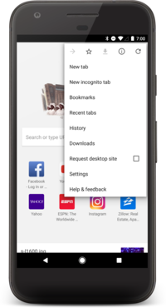
Menu
Options menu
you should include actions and other options that are relevant to the current activity context

Slide 10
Menu
2. Context menu
There are two ways to provide contextual actions:
floating context menu:
A menu appears as a floating list of menu items (similar to a dialog) when the user performs a long-click (press and hold) on a view that declares support for a context menu.
Users can perform a contextual action on one item at a time.
contextual action mode:
Displays a contextual action bar at the top of the screen with action items that affect the selected item(s).
When this mode is active, users can perform an action on multiple items at once (if your app allows it).

Slide 11
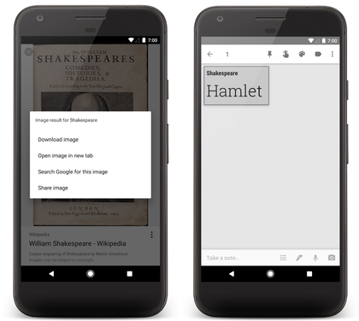
Menu
2. Context menu
floating context menu (left) and the contextual action bar (right).

Slide 12
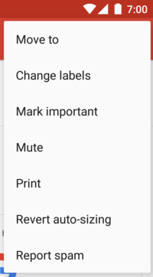
Menu
3. Popup Menu
This is not the same as a context menu, which is generally for actions that affect selected content.
A popup menu in the Gmail app, anchored to the overflow button at the top-right

Slide 13
Enabling batch contextual actions in a ListView or GridView
Implement the AbsListView.MultiChoiceModeListener interface and set it for the view group with setMultiChoiceModeListener().
2. Call setChoiceMode() with the CHOICE_MODE_MULTIPLE_MODAL argument.
In the listener's callback methods, you can specify the actions for the contextual action bar, respond to click events on action items, and handle other callbacks inherited from the ActionMode.Callback interface.

Slide 14
Notification
A notification is a message you can display to the user outside of your application's normal UI.
When you tell the system to issue a notification, it first appears as an icon in the notification area.
You specify the UI information and actions for a notification in a NotificationCompat.Builder object.
To create the notification itself, you call NotificationCompat.Builder.build(), which returns a Notification object containing your specifications.

Slide 15
Notification
A Notification object must contain the following:
A small icon, set by setSmallIcon()
A title, set by setContentTitle()
Detail text, set by setContentText()
Inside a Notification, the action itself is defined by a PendingIntent containing an Intent that starts an Activity in your application.
If you want to start Activity when the user clicks the notification text in the notification drawer, you add the PendingIntent by calling setContentIntent().

Slide 16
Notification
Notifications remain visible until one of the following happens:
The user dismisses the notification either individually or by using "Clear All" (if the notification can be cleared).
The user clicks the notification, and you called setAutoCancel() when you created the notification.
You call cancel() for a specific notification ID. This method also deletes ongoing notifications.
You call cancelAll(), which removes all of the notifications you previously issued. Replying to notifications.

Slide 17
Progress bar example
Progress bar is useful to tell user that the task is takes longer time to finish
Android has two types of progress bar:
Indeterminate Progress
Use indeterminate mode for the progress bar when you do not know how long an operation will take.
shows a cyclic animation without a specific amount of progress indicated.
Determinate Progress
Use determinate mode for the progress bar when you want to show that a specific quantity of progress has occurred.
For example, the percent remaining of a file being retrieved, or the percent remaining of an audio file that is playing.

Slide 18
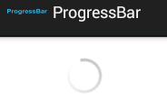

Progress bar example
But if we do not know the amount of work to be done, then we can use progressBar.setIndeterminate(true) in the activity class programatically or using " in the layout xml android:indeterminate="true
Indeterminate Progress
Determinate Progress
Horizontal
Round Progress bar

Slide 19
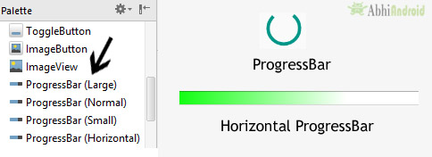
Progress bar example
In Android, by default a progress bar will be displayed as a spinning wheel but If we want it to be displayed as a horizontal bar then we need to use style attribute as horizontal.
Difference between ProgressBar and ProgressDialog:
ProgressBar is a view indicating the amount of progress done. The application can change the value.
On the other side ProgressDialog is a dialog box (like alert). The user must wait for the progress to complete.

Slide 20
Progress bar example
You can update the percentage of progress displayed by using the setProgress(int) method, or by calling incrementProgressBy(int) to increase the current progress completed by a specified amount.
By default, the progress bar is full when the progress value reaches 100.
The key to use progress bar is using “Thread” to run your time consume task and another “Thread” to update the progress bar status accordingly.
Make the thread to sleep for, say 200 milliseconds, after incrementing the value to show the progress slowly.

Slide 21
Sending SMS
you can use SmsManager API or device’s Built-in SMS application to send a SMS message.
Both need SEND_SMS permission in the Manifest fie
<uses-permission android:name="android.permission.SEND_SMS" />
The Built-in SMS application solution is the easiest way, because you let device handle everything for you.

Slide 22
Sending SMS
SmsManager API
Get the default instance of the SmsManager
SmsManager smsManager = SmsManager.getDefault();
2. Send a text based SMS.
smsManager.sendTextMessage(String destinationAddress, String scAddress, String text, PendingIntent sentIntent, PendingIntent deliveryIntent)

Slide 23
Sending SMS
SmsManager API
you will call the getDefault() static method to obtain an SmsManager object.
The sendTextMessage() method sends the SMS message with a PendingIntent.
The PendingIntent object is used to identify a target to invoke at a later time.
If you need to monitor the status of the SMS message sending process, you can actually use two PendingIntent objects together with two BroadcastReceiver objects.

Slide 24
Sending SMS
Built-in SMS application
You can use Android Intent to send SMS by calling built-in SMS functionality of the Android.
You will use ACTION_VIEW action to launch an SMS client installed on your Android device.
Intent smsIntent = new Intent(Intent.ACTION_VIEW);
To send an SMS you need to specify smsto: as URI using setData() method
smsIntent.setData(Uri.parse("smsto:"));
SMS to be sent is specified as
sendIntent.putExtra("sms_body", message);

Slide 25
Broadcast Receiver
A broadcast receiver (receiver) is an Android component which allows you to register for system or application events.
All registered receivers for an event are notified by the Android runtime once this event happens.
A receiver can be registered via the AndroidManifest.xml file.
Alternatively to this static registration, you can also register a receiver dynamically via the Context.registerReceiver() method.

Slide 26
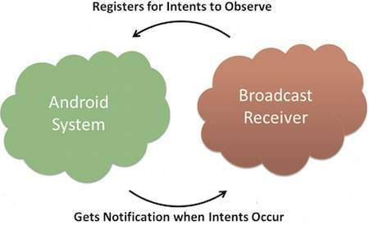
Broadcast Receiver
If the event for which the broadcast receiver has registered happens, the onReceive() method of the receiver is called by the Android system.
Thus, a broadcast receiver is implemented as a subclass of BroadcastReceiver class and overriding the onReceive() method, where each message is received as a Intent object parameter

Slide 27
Broadcast Receiver
Since Android API 11, you could not perform any asynchronous operation in the onReceive() method.
After the onReceive() of the receiver class has finished, the Android system is allowed to recycle the receiver.
The following lists a few important system events.
Intent.ACTION_BOOT_COMPLETED
Intent.ACTION_POWER_CONNECTED
Intent.ACTION_POWER_DISCONNECTED
Intent.ACTION_BATTERY_LOW

Slide 28
Example Register a receiver for incoming phone calls
To obtain incoming call details , we use Bundle class instance return by intent.getExtras();
Bundles are generally used for passing data between various Android activities.
Bundles can hold all types of values and pass them to the new activity.

Slide 29
Android - Services
A service is a component that runs in the background to perform long-running operations without needing to interact with the user and it works even if application is destroyed.
A service can essentially take two states
Started
Bound

Slide 30
Android - Services
Started:
A service is started when an application component, such as an activity, starts it by calling startService().
Once started, a service can run in the background indefinitely, even if the component that started it is destroyed.
Bound
A service is bound when an application component binds to it by calling bindService().
A bound service offers a client-server interface that allows components to interact with the service, send requests, get results.

Slide 31
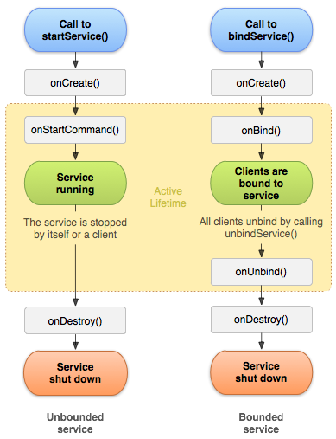
Android - Services
A service has life cycle callback methods that you can implement to monitor changes in the service's state and you can perform work at the appropriate stage.

Slide 32
Android - Services
Creating a custom service
you create a Java class that extends the Service base class or one of its existing subclasses.
The Service base class defines various callback methods
You don't need to implement all the callbacks methods.
Callback methods : onStartCommand(), onBind(), onUnbind(), onRebind(), onCreate(), onDestroy()

Slide 33
Android - Services
Creating a custom service
you create a Java class that extends the Service base class or one of its existing subclasses.
The Service base class defines various callback methods
You don't need to implement all the callbacks methods.
You also need to register your service in the android manifest xml file.

Slide 34
Android – Services - Callback methods
onStartCommand()
The system calls this method when another component, such as an activity, requests that the service be started, by calling startService().
If you implement this method, it is your responsibility to stop the service when its work is done, by calling stopSelf() or stopService() methods

Slide 35
Android - Services
onBind()
The system calls this method when another component wants to bind with the service by calling bindService().
If you implement this method, you must provide an interface that clients use to communicate with the service, by returning an IBinder object.
You must always implement this method, but if you don't want to allow binding, then you should return null.

Slide 36
Android - Services
onBind()
The system calls this method when another component wants to bind with the service by calling bindService().
If you implement this method, you must provide an interface that clients use to communicate with the service, by returning an IBinder object.
You must always implement this method, but if you don't want to allow binding, then you should return null.

Slide 37
Android - Services
onUnbind()
The system calls this method when all clients have disconnected .
onRebind()
The system calls this method when the clients have reconnected to the service.
onCreate()
The system calls this method when the service is first created using onStartCommand() or onBind().
This call is required to perform one-time set-up.

Slide 38
Android - Services
onDestroy()
The system calls this method when the service is no longer used and is being destroyed.
Your service should implement this to clean up any resources such as threads, registered listeners, receivers, etc

Slide 39
Android - Shared Preferences
Shared Preferences allow you to save and retrieve data in the form of key, value pair.
To use shared preferences, you have to call a method getSharedPreferences() that returns a SharedPreference instance pointing to the file that contains the values of preferences.
SharedPreferences sharedpreferences = getSharedPreferences(MyPREFERENCES, Context.MODE_PRIVATE);
The first parameter is the key and the second parameter is the MODE.

Slide 40
Android - Shared Preferences
Apart from private there are other modes available :
MODE_PRIVATE : setting this mode, the file can only be accessed using calling application.
You can save something in the sharedpreferences by using SharedPreferences.Editor class.
You will call the edit method of SharedPreference instance and will receive it in an editor object.
Editor editor = sharedpreferences.edit();
editor.putString("key", "value");
editor.commit()

Slide 41
Android - Shared Preferences
apply() : It is an abstract method. It will commit your changes back from editor to the sharedPreference object you are calling
clear() : It will remove all values from the editor
remove(String key) : It will remove the value whose key has been passed as a parameter.
putLong(String key, long value) : It will save a long value in a preference editor
putInt(String key, int value) :It will save a integer value in a preference editor.
putFloat(String key, float value) :It will save a float value in a preference editor

Slide 42
Android - WebView
WebView is a view that display web pages inside your application.
You can also specify HTML string and can show it inside your application using WebView.
In order to use it, you have to get a reference of this view
WebView browser = (WebView) findViewById(R.id.webview);
In order to load a web url into the WebView, you need to call a method loadUrl(String url) of the WebView class,
browser.loadUrl("http://www.google.com");

Slide 43
Android - WebView
Apart from just loading url, you can have more control over your WebView by using the methods defined in WebView class.
canGoBack(): This method specifies the WebView has a back history item.
canGoForward(): This method specifies the WebView has a forward history item.
clearHistory() : This method will clear the WebView forward and backward history.
destroy() : This method destroy the internal state of WebView.
findAllAsync(String find) :This method find all instances of string and highlight them
getProgress() : This method gets the progress of the current page.
getTitle() : This method return the title of the current page.
getUrl() : This method return the url of the current page.

Slide 44
Android - WebView
If you click on any link inside the webpage of the WebView, that page will not be loaded inside your WebView. In order to do that you need to extend your class from WebViewClient and override its method.
private class MyBrowser extends WebViewClient
{ @Override
public boolean shouldOverrideUrlLoading(WebView view, String url)
{ view.loadUrl(url); return true; }
}

